Slide 1
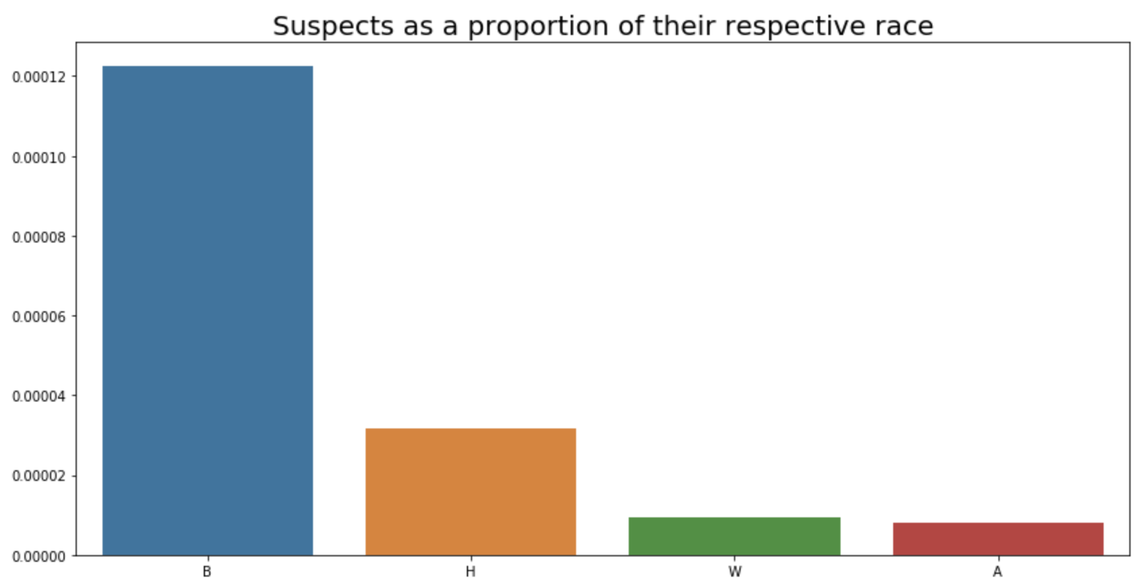
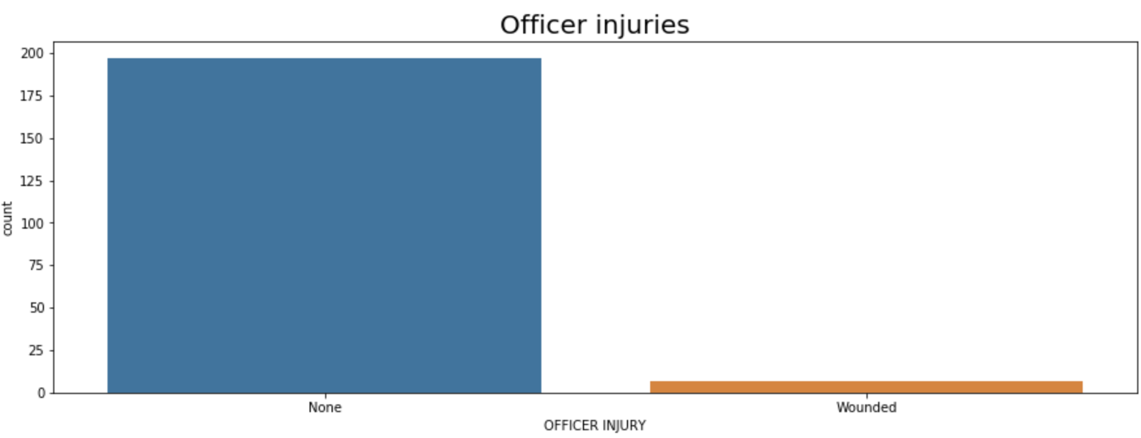
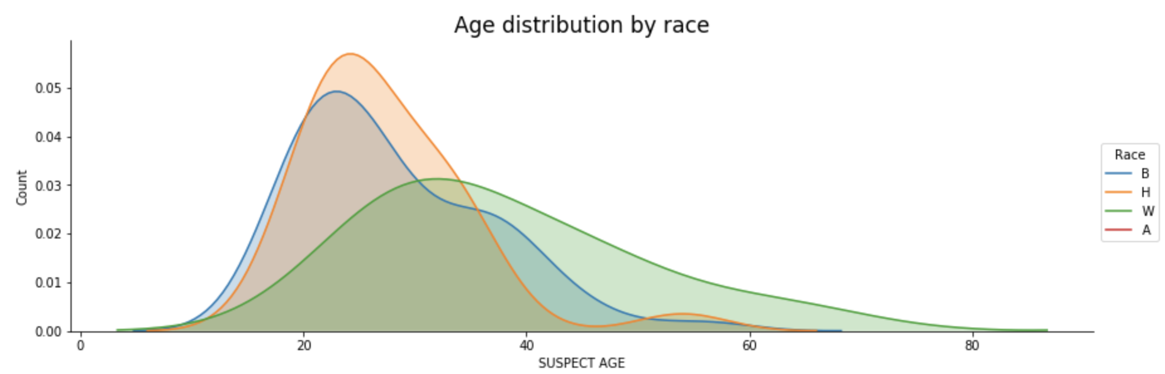
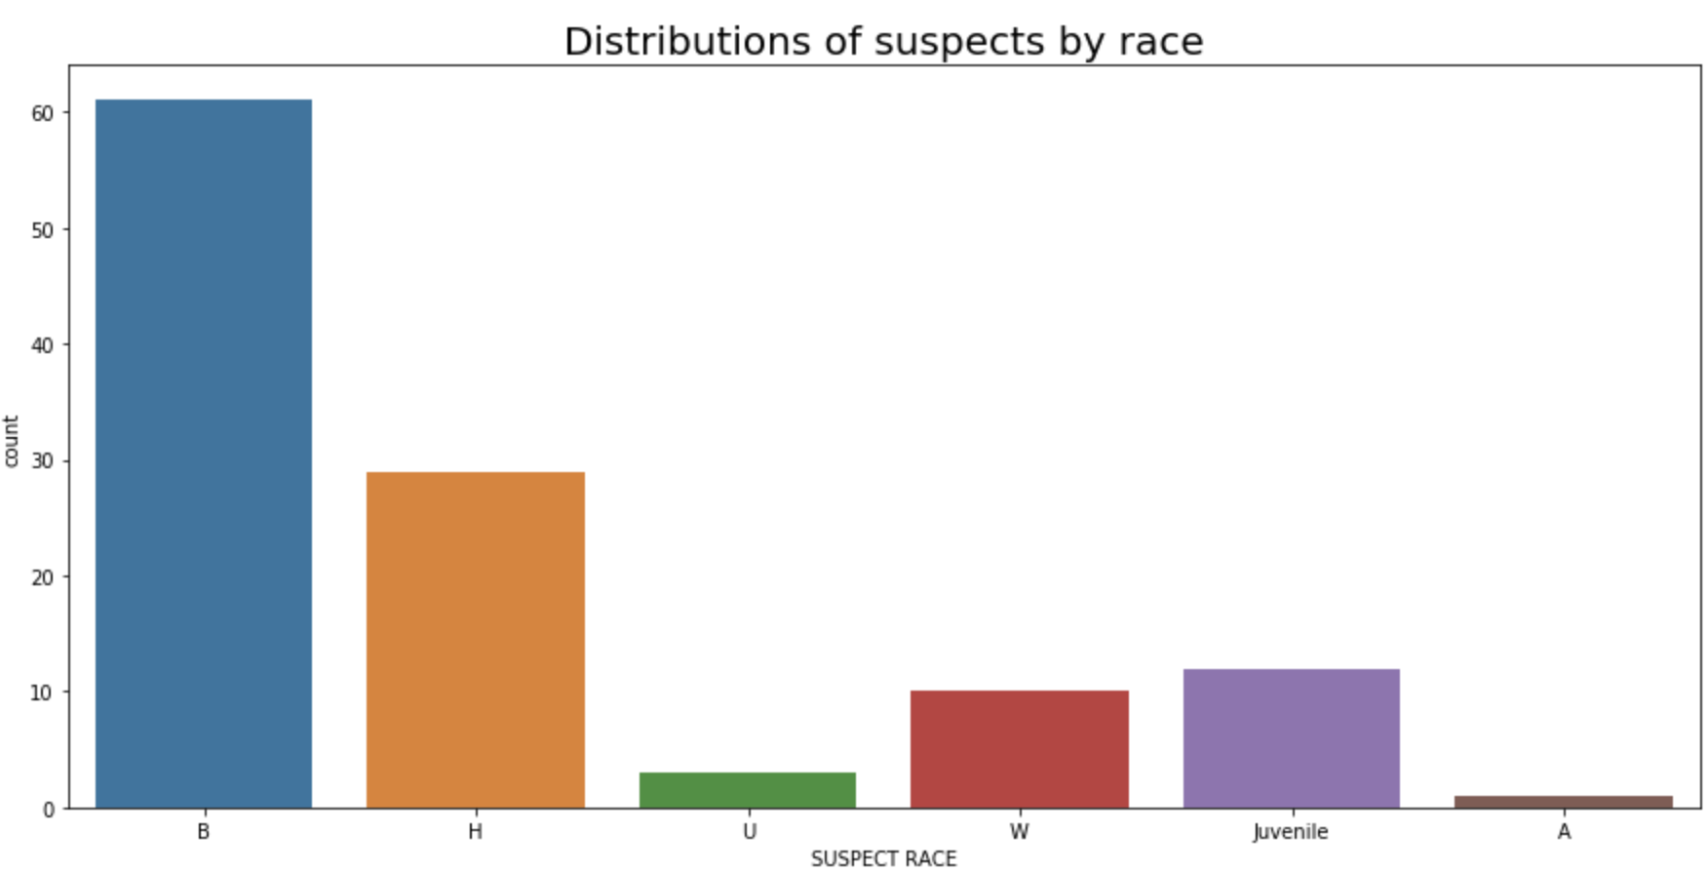
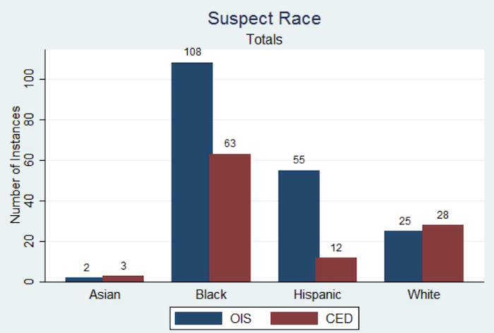
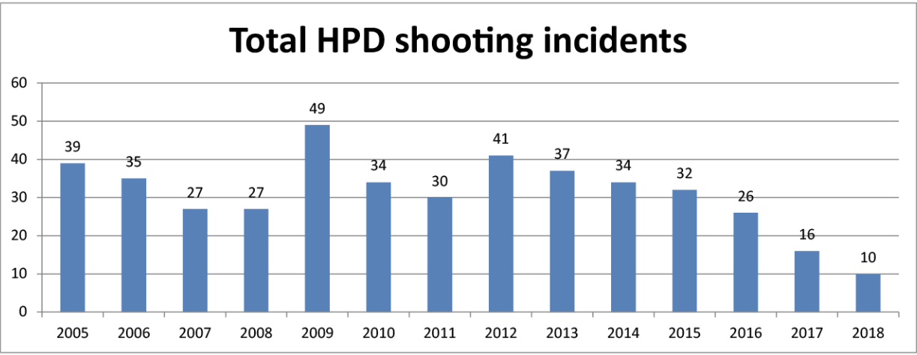
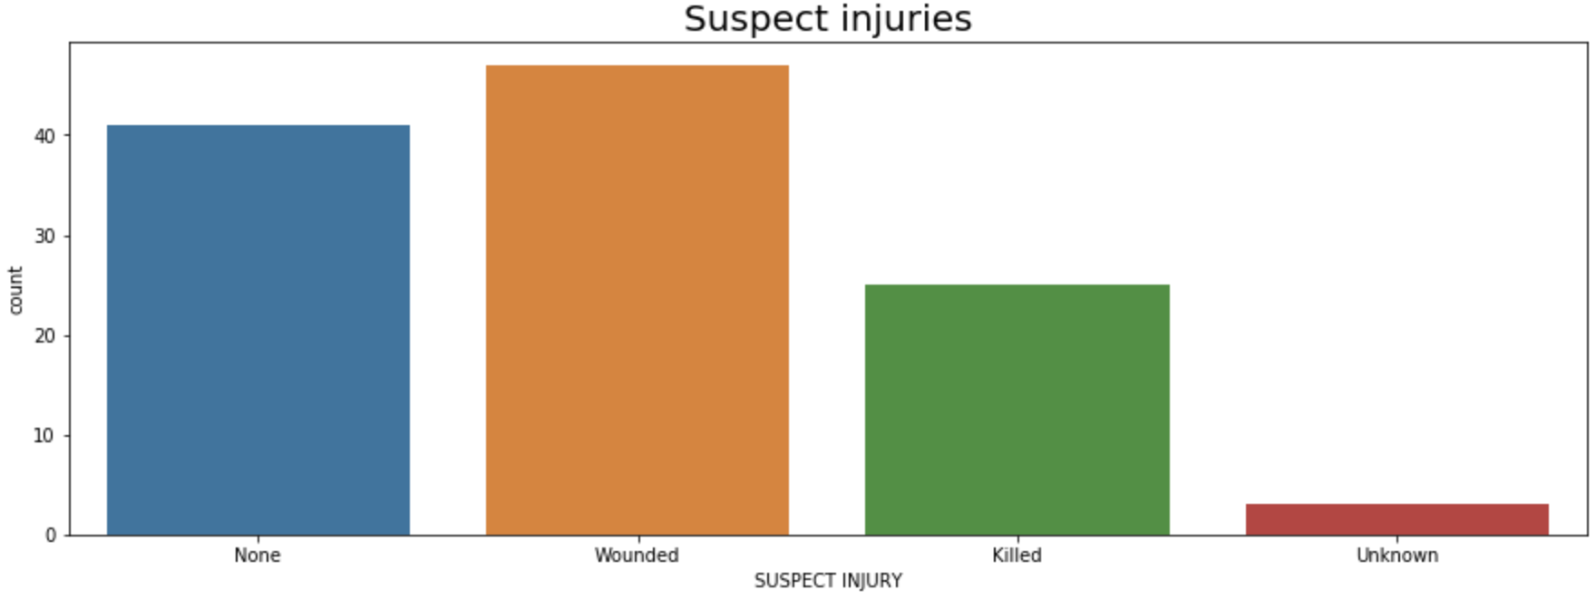
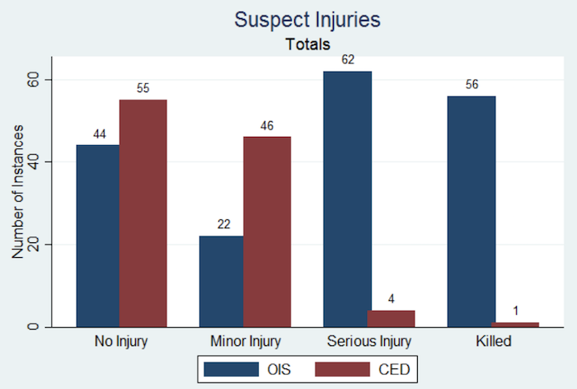
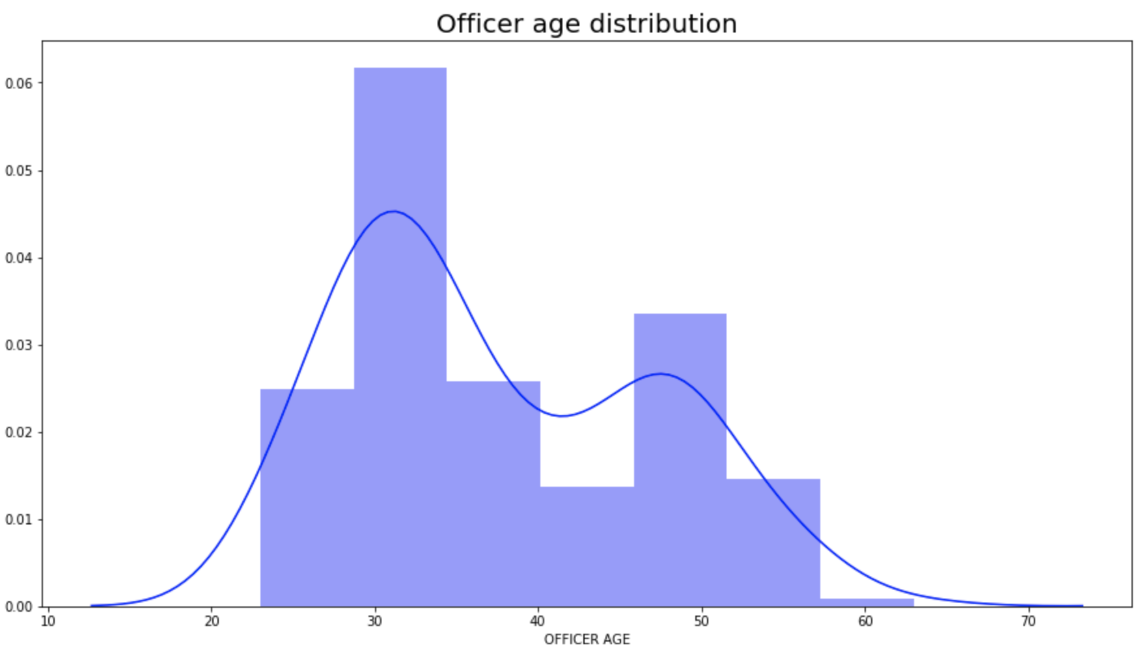
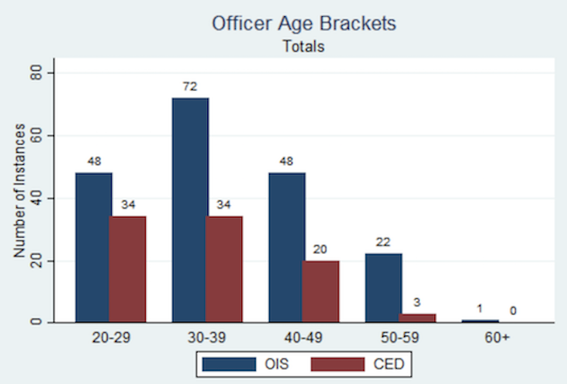
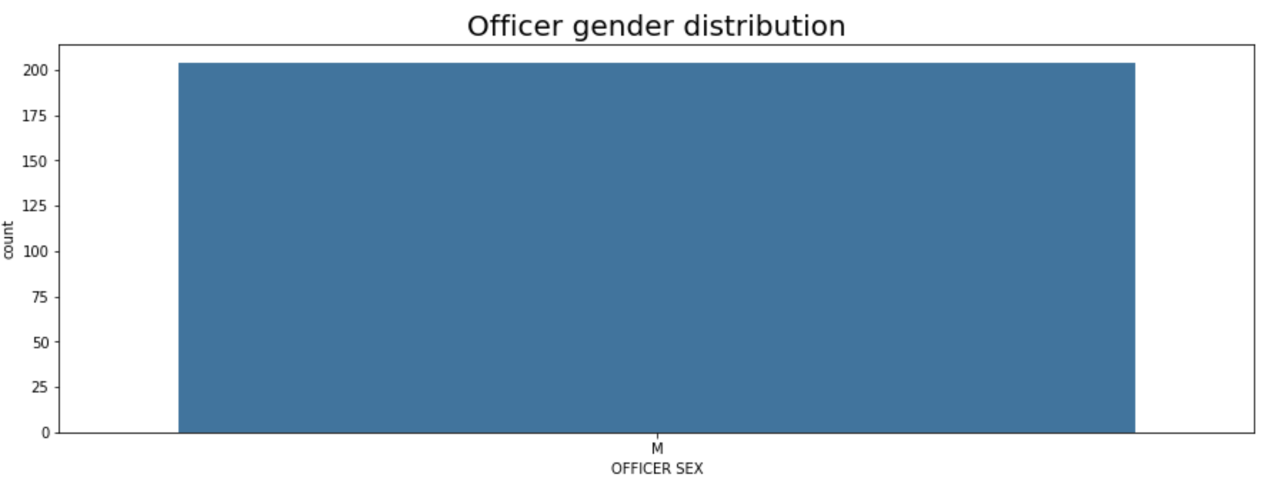
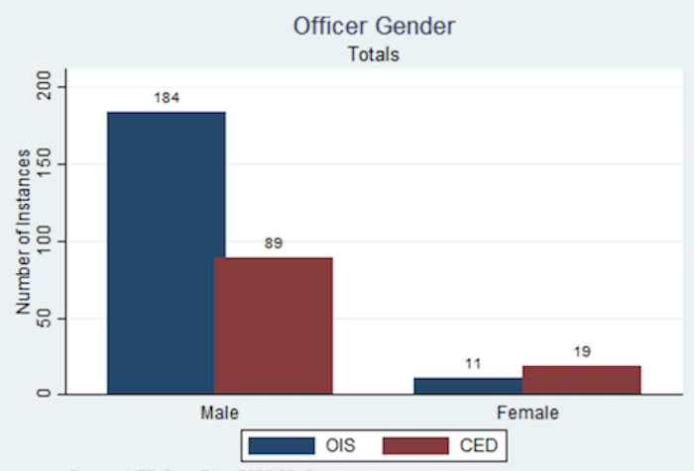
An Analysis of Houston Police Department Officer-Involved Shootings
Nevin George (Cinco Ranch High School) & Max Grossman (Rice University)
Background
Officer-involved shootings (OIS) has been an issue since the establishment of the first American police department in Boston in 1838
Texas State Legislature passed Art. 2.139 of the Texas Code of Criminal Procedure on 9/1/2015, which requires law enforcement agencies to report details of all officer-involved shootings
Since then, OIS per year in Houston has greatly decreased
Geo-coding the Data
Additional Graphs
Blacks are killed at a disproportionate number with respect to the population size of each race in Houston
Escalated enormously following incidents such as the death of Michael Brown in Ferguson, MO and Botham Jean in Dallas, TX
96.6% of officers sustain no injuries
Suspect Graphs
White suspects are on average around 10 years older than black and Hispanic suspects.
Insufficient data on Hispanic suspects
B – black
H – Hispanic
U – Unknown
W – White
A - Asian
Previous Study
Average age of victims: Black – 28.1 White – 37.9
Hispanic – 27.4 Asian – 21.0
In both graphs, black suspects make up 55-60% and Hispanic suspects around 28%
White suspects only make up 9-13%
Models
Tried different models to predict suspect injury
Decision Tree Classifier yielded a 1.0 accuracy score
Accurately identified the suspect injury of every suspect in the test set
During the algorithm, the data goes through a series of conditions, and the final prediction of suspect injury depends on whether it passes or fails those conditions.
Previous Study
Dataset & Previous Literature
HPD maintains records of all OIS in Houston
A previous study by researchers at Northwestern University analyzed trends in the Houston OIS dataset from 2005 to 2013
Officer Graphs
Findings
No significant differences between the graphs of this data and those of the previous study
Lack of change adds evidence that the Act did in fact cause the sharp decline in police shootings
Could not have been caused by race, gender, etc. because those features did not change
Corroborate national police shooting trends such as evidence of racial bias, non-white suspects killed at younger age, and officers rarely injured
Questions
Previous Study
How much of the decrease in Houston OIS can be attributed to the Act?
How do the trends of this data relate to the trends found in the previous study?
What are some new trends, if any, in this data?
What is the likelihood of a suspect being killed in the encounter?
Both graphs have peaks at 30-39 years
Current data also has small peak around 50 years
Previous Study
Features Considered & Tools Used
Suspect and officer sex, race, age, injury
Suspect weapon, officer on duty, # of officers, and response type
Used Python, Pandas, matplotlib, Seaborn plots
Future Steps
The results of this study may be shared with the HPD, which could be useful when deciding future policies
Current data – 100% male officers
Previous study – 94% male officers
Male-dominated officer force

